Slide 1



Nim for Hackers 2

Slide 2
Nim
Nim has recently released version 2.0.0 which contains a lot of changes, such as:
Default memory manager as orc; arc/orc improvements
Threads on by default
New standard library modules (abstracted from previous std lib)
Default object types
Benefits of nim:
Fast compile times
Memory safety
Readability of Python
Enjoyable (subjective)
Various compilations (wanna compile code for Nintendo Switch, feel free)
Systems programming language
Negatives of nim:
No commercial backing
Lack of libraries
White space formatting (subjective)

Slide 3
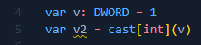
Nim - from other langs
Nim for C programmers
Will do a lot of type casting; considered unsafe and the programmer knows what they are doing
Can use template to simulate C’s macros; the `{.emit.}` pragma can also be used
Nim for Python programmers
Nim’s syntax is very pythonic - if you know python, you know how to write in nim.

Slide 4
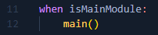
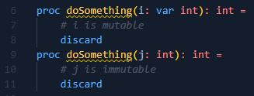
Nim - from other langs (random stuff)
Storing data at compile time: (alias for staticRead)
Self-Execution of Main Module:
proc vs func: procedure (normal functions); function (no side effects), this is essentially and is used when the function should not access global or thread-local variables (a pure function). Eg: Don’t use echo inside of func because it mutates stdout; use debugEcho.
Async macro: `{.async.}` pragma will convert functions to be asynchronous.
Syntax with windows API can get ugly with many cast statements (type casting)
`-d:danger` disables all checking (int overflow, bounds checks, etc.); will commonly use this…
Without `-d:release`, a debug build is compiled (very slow)
If you import a module, only the procedures, objects, etc. used will be compiled into the code.
Values are only mutable if var is in the function:

Slide 5
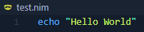
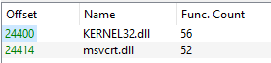
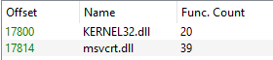
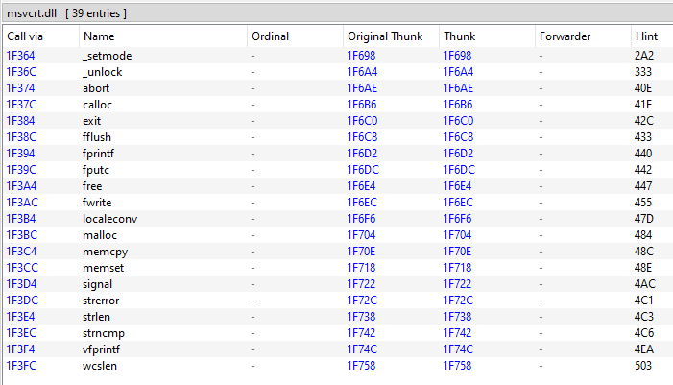
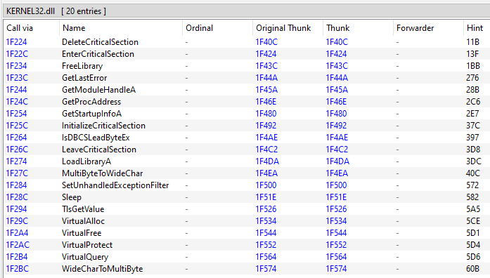
Nim - opsec
Compiling a basic “Hello World” binary with: nim c -d:release .\test.nim
This uses these compiler options: Hint: mm: orc; threads: on; opt: speed; options: -d:release
This includes a lot of imported functions from KERNEL32.dll and the c runtime
If compiled with: nim c -d:release --threads:off .\test.nim
It’s possible to have these two libraries not link with the binary. Let’s look at the second compiled binary.
msvcrt.dll is the c runtime

Slide 6
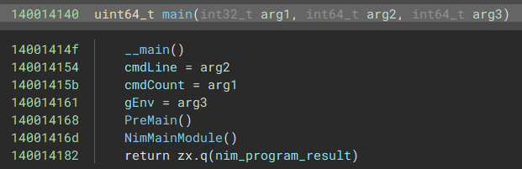
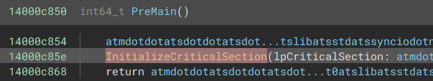
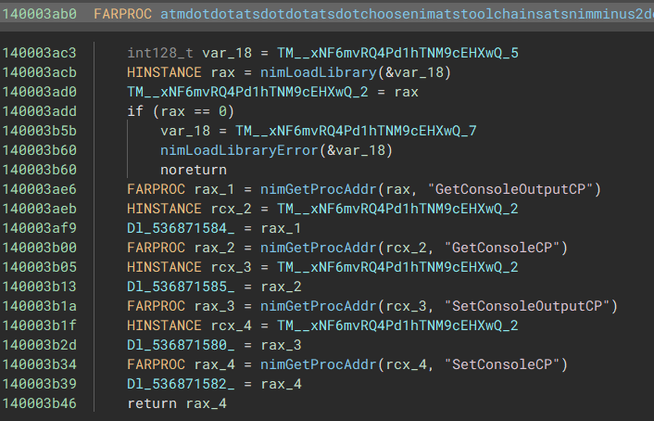
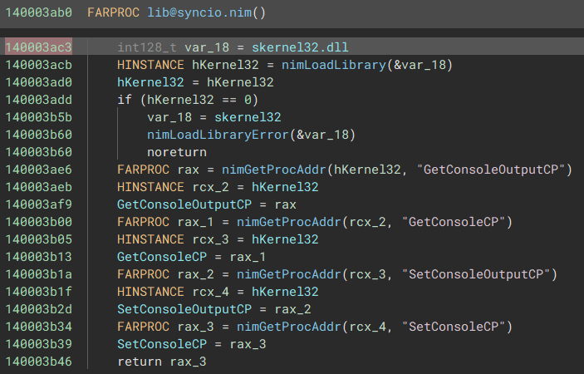
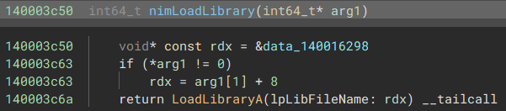
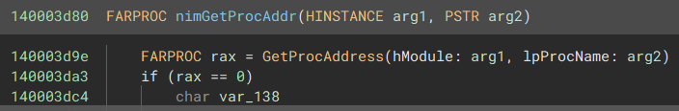
Looking at test.exe - part 1
main calls PreMain and NimMainModule.
PreMain calls some ugly functions. At 0xc854 this is lib@syncio.nim
nim wrapper for LoadLibrary and GetProcAddress

Slide 7
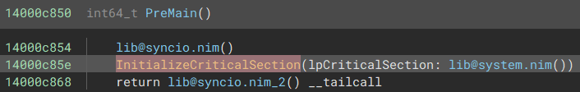
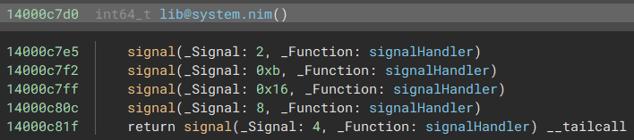
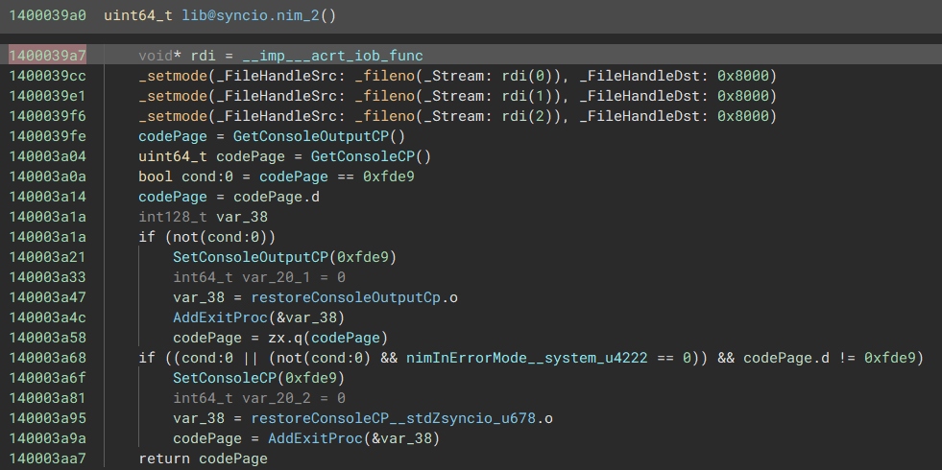
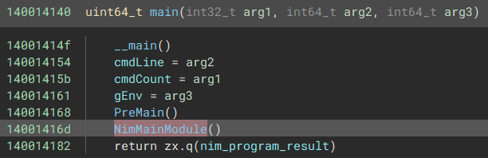
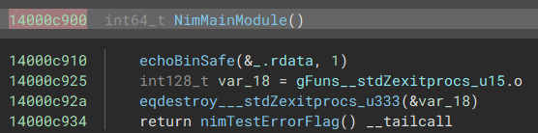
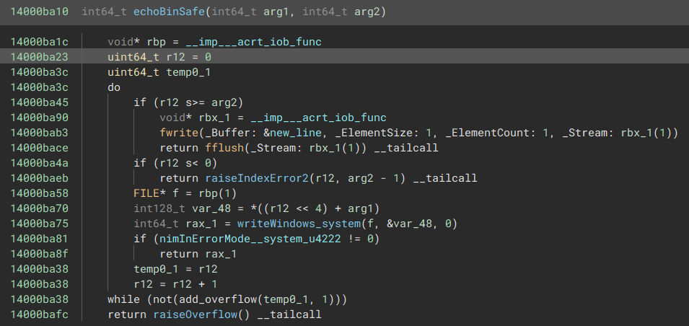
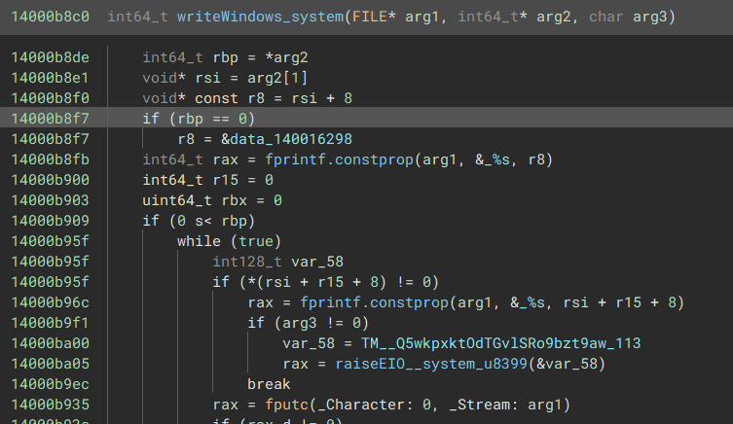
Looking at test.exe - part 2
InitializeCriticalSection sets up signals
The final __tailcall will setup the Console for output
back to main ->
_.rdata contains the string “Hello World”. It is called with echoBinSafe
___imp___acrt_iob_func contains handles to stdin, stdout, stderr
writeWindows outputs one char at a time checking for overflows and errors (out of bounds)

Slide 8
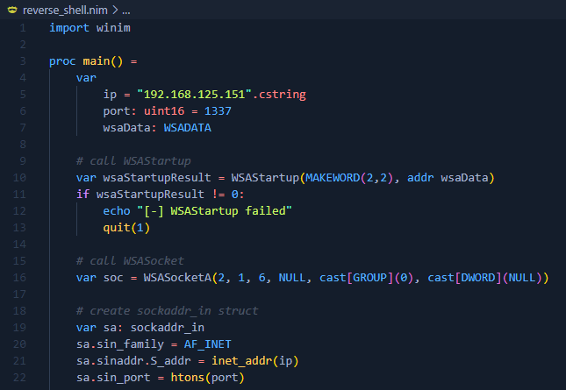
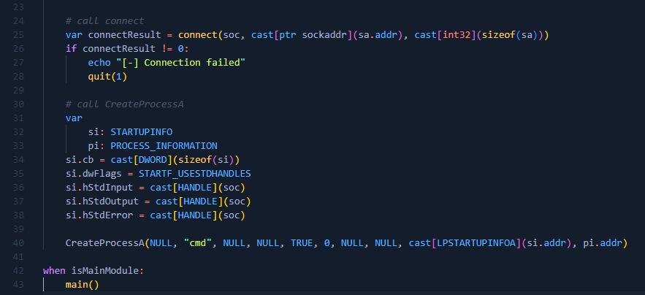
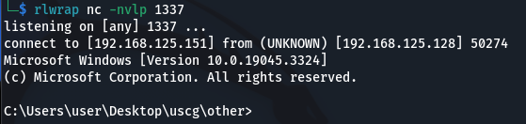
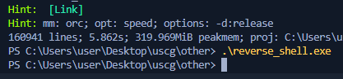
Reverse shell - Windows
With winim, a library wrapping the windows API and COM, the winapi can be used entirely to write a reverse shell.
Compiling with: nim c -d:release --threads:off .\reverse_shell.nim

Slide 9
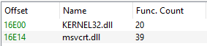
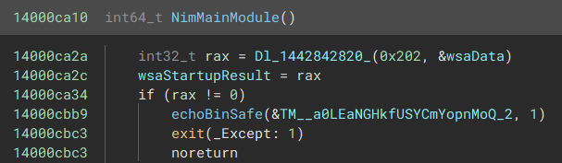
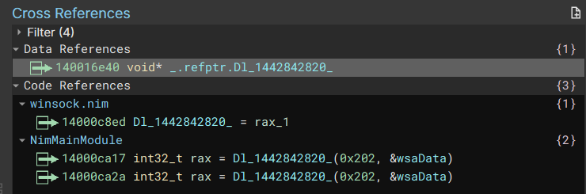
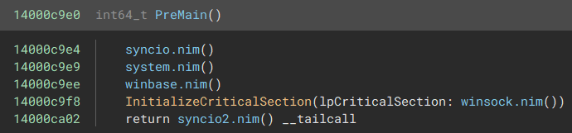
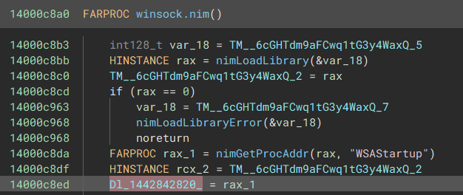
Looking at reverse_shell.exe - part 1
Remember back to the imports of test.exe where KERNEL32.dll and msvcrt.dll imported 20 and 39 functions respectively. The reverse_shell.exe imports the same.
This is because nim is using its nimGetProcAddress wrapper during PreMain.
Dl_1442842820 is a pointer to the FARPROC WSAStartup

Slide 10
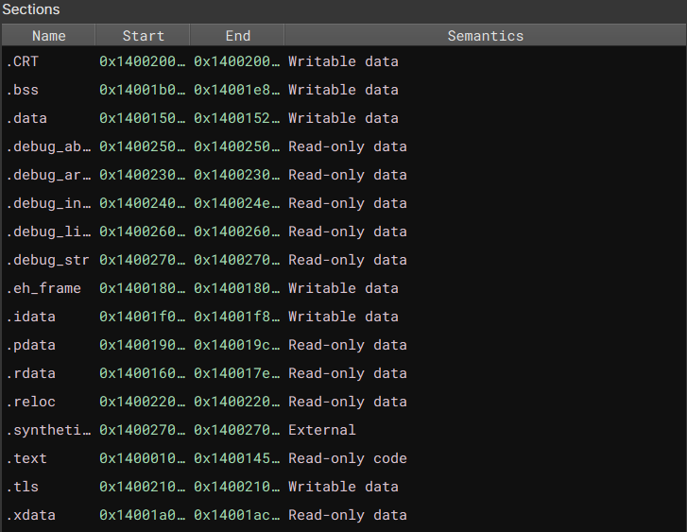
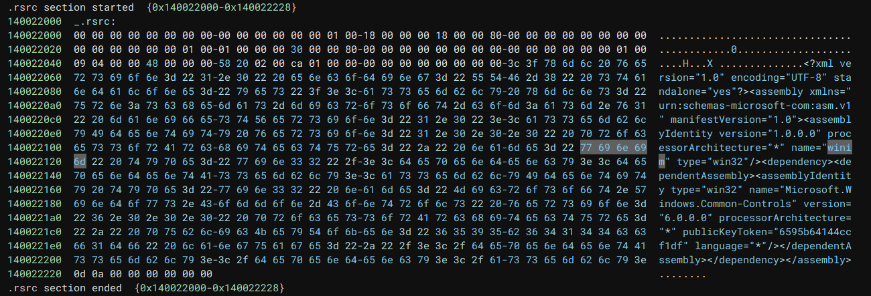
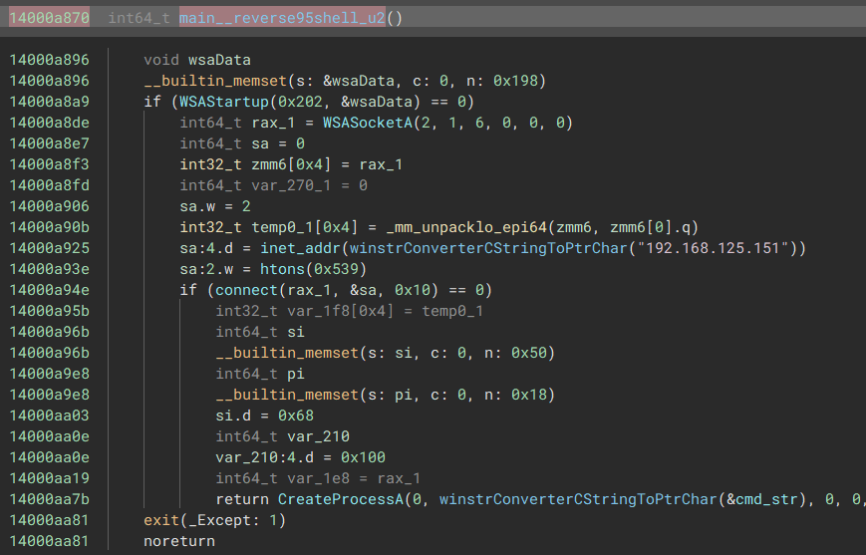
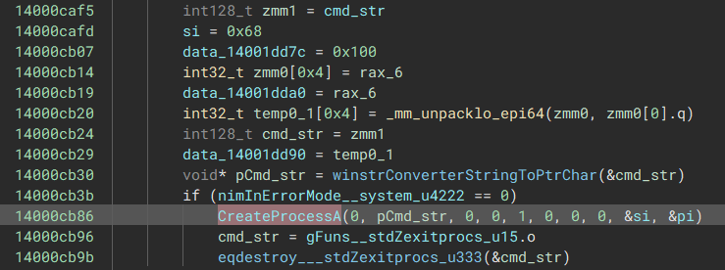
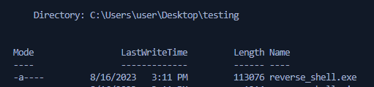
Looking at reverse_shell.exe - part 2 - opsec concerns
winim embeds data in the resource section. Compiling with “-d:noRes” will remove this
CreateProcessA calling “cmd” is not stealthy
The file size is brought down in 113kb
Nim is importing a lot of stuff that might not be useful, like memory management. In nim objects and arrays are stored on the stack - everything is in the heap. We can remove the strings (or replace with cstring) and compile with `--mm:none`. This simplifies the binary a bit.

Slide 11
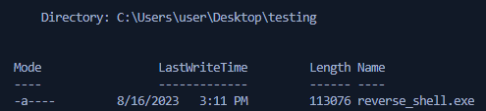
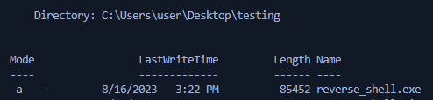

Looking at reverse_shell.exe - part 3 - opsec concerns
Can bring the file size down even more with some added compilation flags. The command used is: `nim c -d:danger --threads:off -d:noRes --mm:none --opt:size --passC:"-s" .\reverse_shell.nim`
The binary has been compiled to optimize for size and stripped. -d:danger will remove all checks and assertions
Nim binaries can be made even smaller, Nim binary size is an article that mainly focuses on UNIX binaries, but is useful.
Compiling with clang gives some regression: `nim c --cc:clang -d:danger --threads:off -d:noRes --mm:none --opt:size --passC:"-Os,-s," .\reverse_shell.nim`
Using tcc for compilation can being it down to half again: `nim c --cc:tcc -d:danger --threads:off -d:noRes --mm:none --opt:size --passC:"-s" .\reverse_shell.nim`
Q: How can we get the binary smaller?
A: Remove Nim

Slide 12
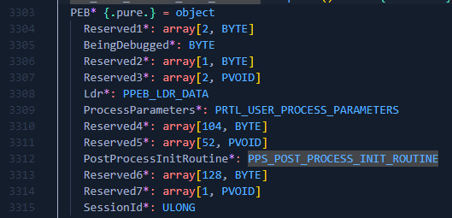
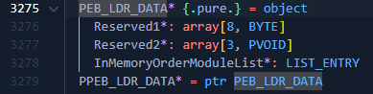
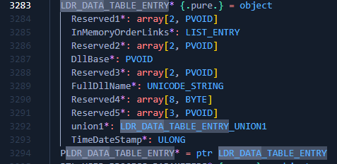
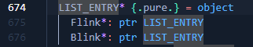
Parsing PEB - custom GetModuleHandle
The PEB (Process Environment Block) contains a list of loaded modules and their addresses.
winim has the structure of the PEB
Assumption is for 64-bit only. In 64-bit PEB is located at the offset of gs:[0x60], where in 32-bit it is at fs:[0x30]
Q: Why do this? A: Goal is to create a nim compiled binary that doesn’t look like it was compiled from nim (nim compiler signatures). The resulting binary can become pretty trivial to RE.

Slide 13
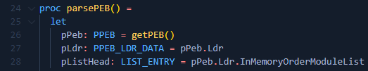
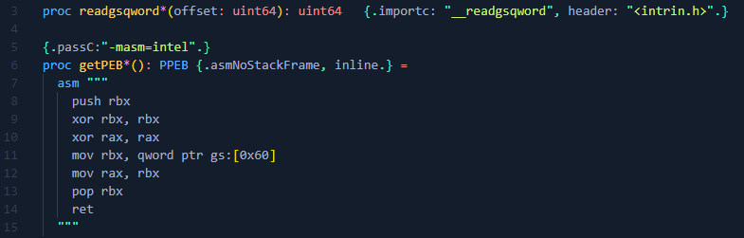
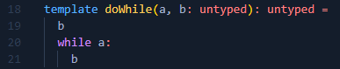
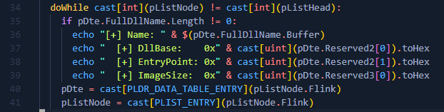
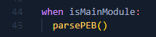
Parsing PEB - custom GetModuleHandle
First, need to get a pointer to the PEB (PPEB). This can be done two ways - with asm(prefered) or importing. The `{.passC.}` pragma is used to specify that intel syntax is used.
Next, define a procedure.
pPeb -> pointer to PEB
pLdr -> pointer to LDR_DATA
pListHead -> list entry; used to get Forward Link
pDte -> LDR data table entry, since the Flink points to a pointer to the first LDR_DATA_TABLE_ENTRY, cast it to a pointer
pListNode -> pointer to a list entry, in this case the first link of the head
Next, define a doWhile template since it is not present in nim..
doWhile is needed because the first run pListNode and pListHead will be the same.
While the current pointer to a list node is not the pointer to the list head:
Check if the LDR_DATA_TABLE_ENTRY has a DllName with a length.
If it does, display information
After, update the pointer to the DTE and update the current pointer to the ListNode
Run from main:

Slide 14
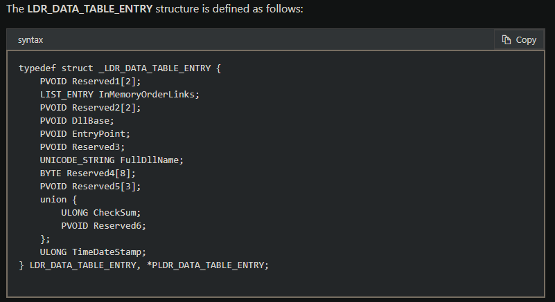
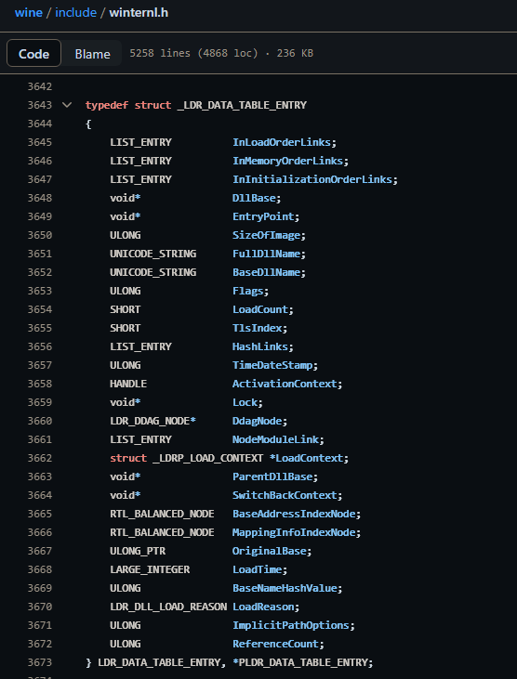
Parsing PEB - custom GetModuleHandle
Notice how Reserved members of the pDte object (structure) are accessed. This is because Microsoft has undocumented structures
From Windows App Development:
The LDR_DATA_TABLE_ENTRY object from winim can be compared to the undocumented structure to retrieve unknown members. Winim builds their api from Microsoft’s official documentation
Will have to look elsewhere for the winternl.h header, such as from wine's github or phnt-single-header

Slide 15
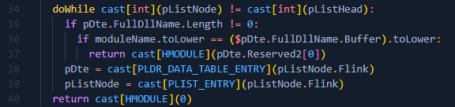
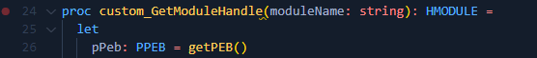



Parsing PEB - custom GetModuleHandle
The logic of the comparison can be replaced to return a handle to the module.
The procedure is updated to take a string and return the dll base address
Full code

Slide 16





Parsing PEB - custom GetModuleHandle
Custom function
Calls winLoadLibrary (just LoadLibraryA)
What nim does: Imports LoadLibraryA from windows.h, LibHandle is just a pointer
How would we get a handle with nim stdlib? dynlib documentation

Slide 17





Parsing DOS HEADER - custom GetProcAddress
In the OPTIONAL_HEADER can access DataDirectory at the entry export (IMAGE_NUMBEROF_DIRECTORY_ENTRIES)
IMAGE_NT_HEADERS is at image_base + IMAGE_DOS_HEADER.e_lfanew
From the NT_HEADERS can get the Optional Header

Slide 18




Parsing DOS HEADER - custom GetProcAddress
We need to parse the Export Directory of the Optional Header
We need to parse the Export Directory of the Optional Header

Slide 19
Parsing DOS HEADER - custom GetProcAddress
Create proc - we cast the handle of the module to an int for use
Cast the base of the module to the IMAGE_DOS_HEADER and check that it matches IMAGE_DOS_SIGNATURE
Get the IMAGE_NT_HEADERS from the base of the module +
IMAGE_DOS_HEADER.e_lfanew. Check that the IMAGE_NT_SIGNATURE matches.
Get the IMAGE_OPTIONAL_HEADER from the IMAGE_NT_HEADERS and the IMAGE_EXPORT_DIRECTORY from the IMAGE_OPTIONAL_HEADER
We need some pointers to arrays of DWORDs. The FunctionNameArray, FunctionAddress Array, and FunctionOrdinalArray

Slide 20


Parsing DOS HEADER - custom GetProcAddress
Setup a while loop to iterate over the number of functions present in IMAGE_EXPORT_DIRECTORY
pFunctionName gets the current index (i) of the functionNameArray and casts it to a string.
pFunctionAddress is the address of the function retrieved from the functionAddressArray at its ordinal
If the pFunctionName is equal to the apiName that we are looking for, we return the pFunction Address
Error checking for if the function is not found happens outside of this function, as it will return 0 if the ProcAddress is not found. This can be seen on the last slide
Putting it all together:

Slide 21





Parsing DOS HEADER - custom GetProcAddress
nim c -r -d:danger --opt:size .\getprocaddress.nim
Nim’s implementation in dynlib
Compared to winim’s import

Slide 22
Putting it all together
Using our custom written GetProcAddress and GetModuleHandle, we can write a nim program that doesn’t rely on the nim compiler to include the common imports from KERNEL32 and the C runtime.

Slide 23



Putting it all together
Import our modules and start setting up our project.
winim is needed for typing.
Create a directory structure
We will use a nim.cfg that I’ve modified from Bitmancer. This will do the lifting for ensuring that nothing is being imported into the program, optimizing for size, stripping symbols, etc..
A similar change it added to our custom GetProcAddress function.
Because we are no longer including the c runtime, we can’t do comparisons with nim, we have to roll our own memcmp. For example in our custom GetModuleHandle:
The comparison of two strings - relies on nim code; can’t have that.
We implement our own custom memcmp function to handle the comparisons.
toLower allows us to compare case insensitive
memcmp needs to handle both regular chars and wide chars, the charSize will be passed in to handle wchars (size 2)
memcmp.nim is in the utils folder and is imported into getmodulehandle.nim and getprocaddress.nim

Slide 24




Putting it all together
In main.nim. We will declare the functions that we will be importing. We get the information from the Windows API documentation. These need to be included because we will typecast our retrieved ProcAdders into these procedures.
We declare some data we will be using. We specify cstring since nim strings are memory managed and we don’t want that. (s<var_name> just specifies string)
Declare strings for handles and ProcAddrs’
Using the custom functions, get HMODULE and the ProcAddress for LoadLibrary
From here, we can load the “ws2_32.dll” library and resolve all the functions we need

Slide 25





Putting it all together
We have resolved all the procedures we need, so now we can start actually writing code. We will reimplement the reverse shell written earlier.
We pass in our cstrings to the pointer of where the string starts (addr sHost[0])
Compile with: nim c -d:mingw .\main.nim (I have commented out the stripping of symbols --l:"-Wl,-s") and this gets us to 13kb in size.
Now we have no imports
If we strip the symbols
Notes: We have done zero error handling, who needs it.

Slide 26




Putting it all together - viewing in binja
We compiled without stripping to see what we’ve created. Some renaming of symbols done.
We could have put main() in the `when isMainModule` to avoid calling the main function from `_start()`
Strings stored in .rdata

Slide 27






Putting it all together - executing
Compiled with the program stripped gets the file down to 3kb.
Setup a listener
Run program
Catch shell
Compared to the originally written reverse shell
Viewing in System Informer the cmd.exe process is running
What can be done next: xor encode or encrypt strings used, anti-debugging, file bloating, etc..

Slide 28




Extra
Debugging is hard since we don’t have access to the c runtime (can’t write to stdout.)
We can resolve the CFile pointer ourselves:
From crtio.nim:
Debug printing
We resolve imports from MSVCRT (msvcrt.dll)

Slide 29




Extra - xor encoding strings
We can make modifications to xor encode the strings
Use the compileTime function on our current strings
Create a compile time function to create our encoded strings at compile, and a runtime instruction to decode at runtime. Alternatively, we could use `{.inline.}` to inline the xor-decoding.
`singleByteXor` is returning an array, we do this so we can cast it to `cstring`s on the stack.
Use the runtime function to decode the xor encoded strings.
All of the `s<stringName>Un` arrays are casted to `cstring`, since this is what our procedures required.
Since cstrings are null terminated, we need to make sure that our key does not create any null characters. We can do this by ensuring that our key isn’t an ascii character, or one that isn’t used. Or modifying our singleByteXor functions to detect a NULL character and xoring with another value.

Slide 30




Extra - xor encoding strings
The .rdata section before and after
View from main()
The non-inlined xor implementation

Slide 31

Extra - anti-debugging
Anti-debugger capabilities can be added to the binary through parsing the PEB. This can act as a replacement for `IsDebuggerPresent` in KERNEL32.DLL
This capability can easily be patched out. This logic can be inlined as a procedure of as a template to make it have tiny bit more work for patching out.

Slide 32
Thank you
Questions and Answer time

